Slide 1










CI/CD education project
Developed by: Teliatnikov M.G
1

Slide 2



Jenkins Server
AWS Server
Clone from github test-branch
Install docker and pull docker images from Docker hub
Push code
Webhook
Clone from github prod branch
Ansible Playbook
AWS Server
Install apache, php7.0 and mariadb client
Connect
Connect
Db server
Db client

Slide 3
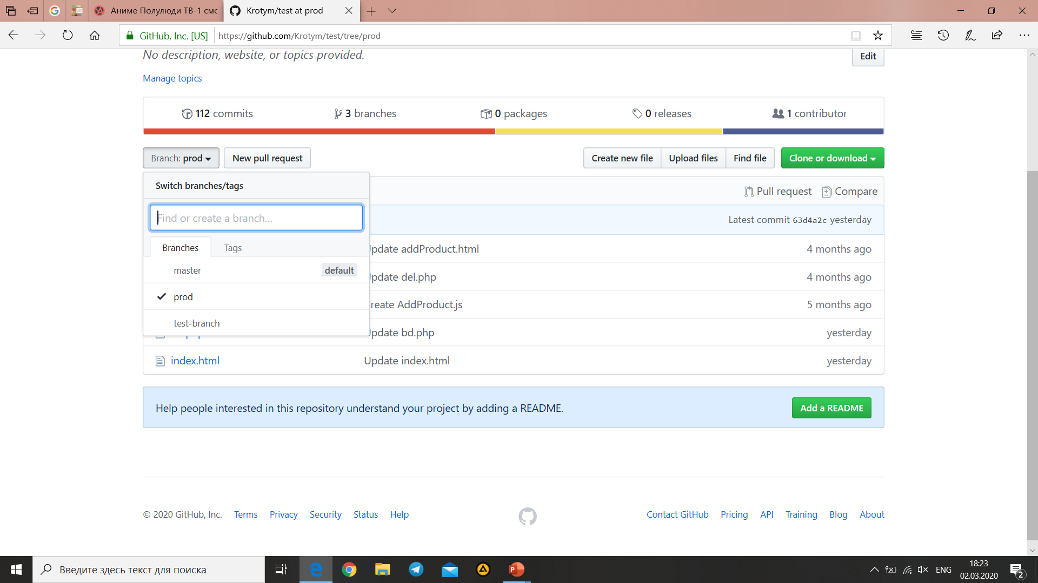
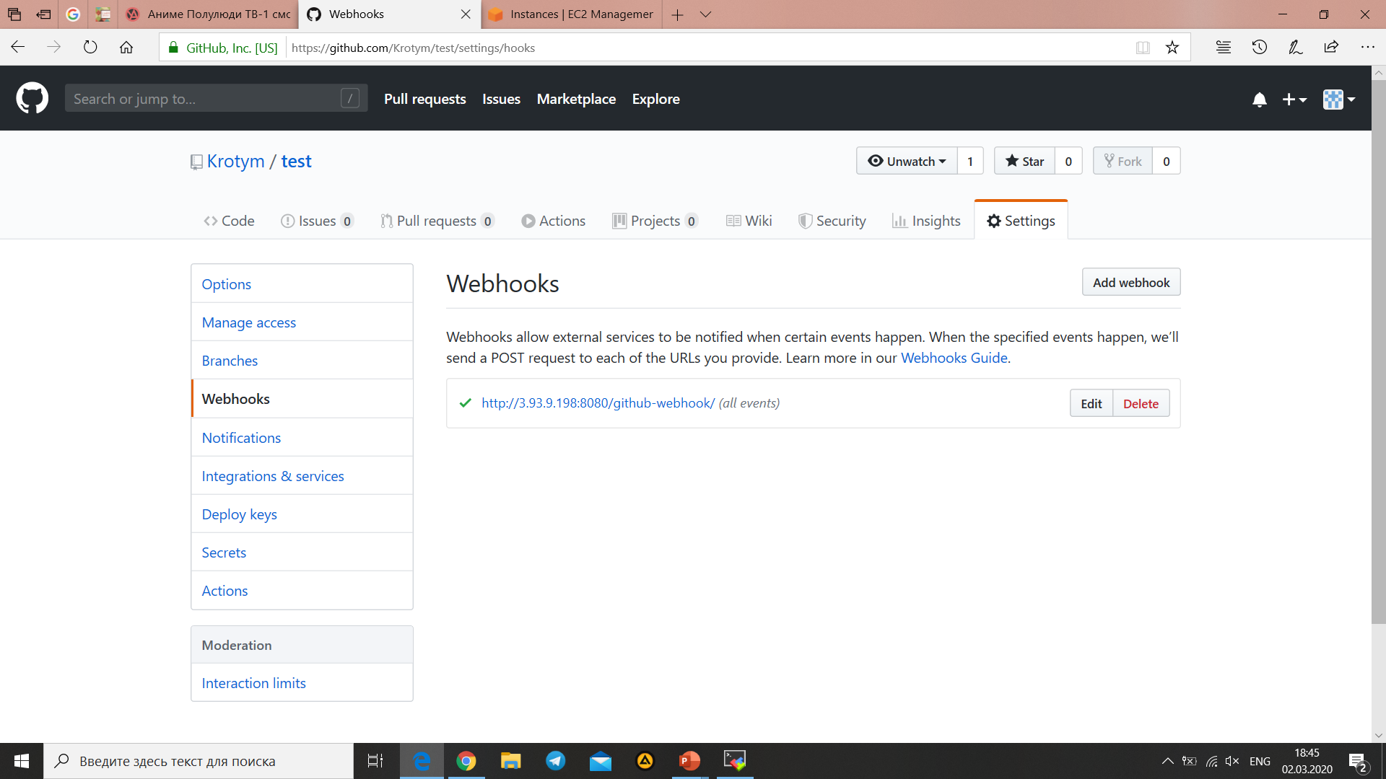
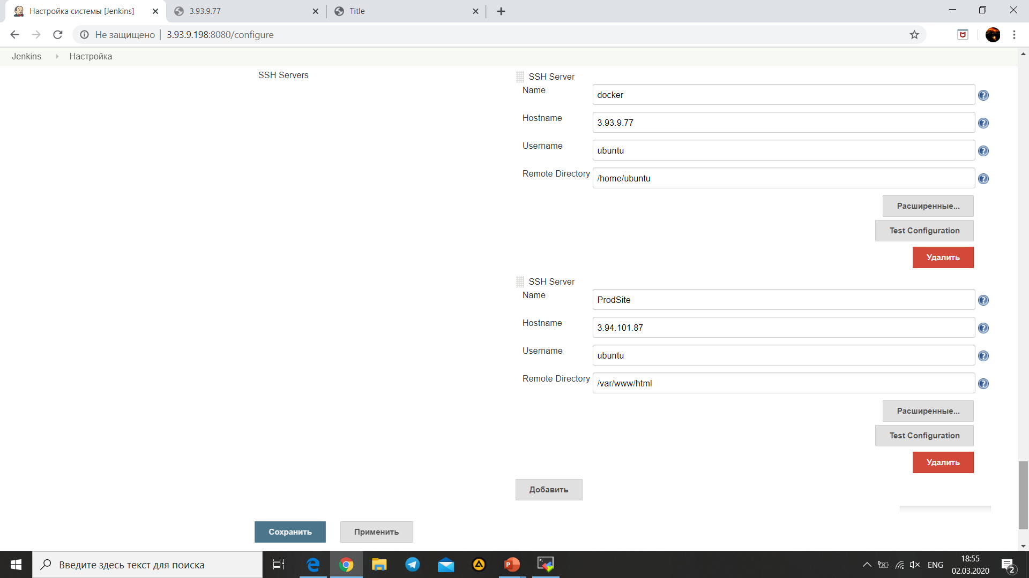
Webhook on Jenkins server
Configure Public Over Ssh
My branches github
On this slide views branches on github, webhook for Jenkins and configuration from plugin jenkins

Slide 4
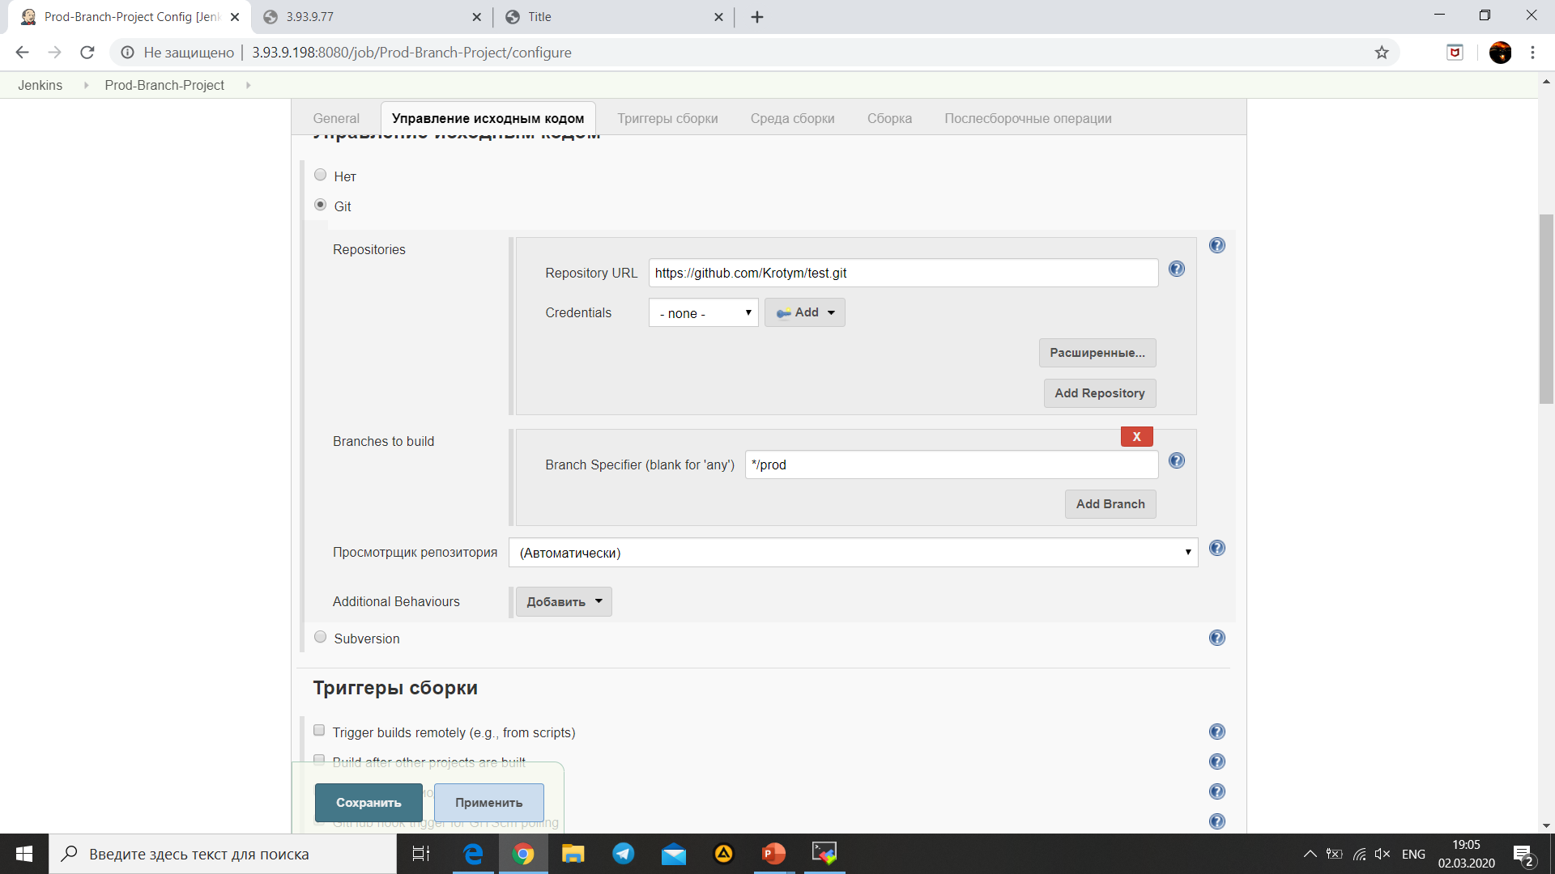
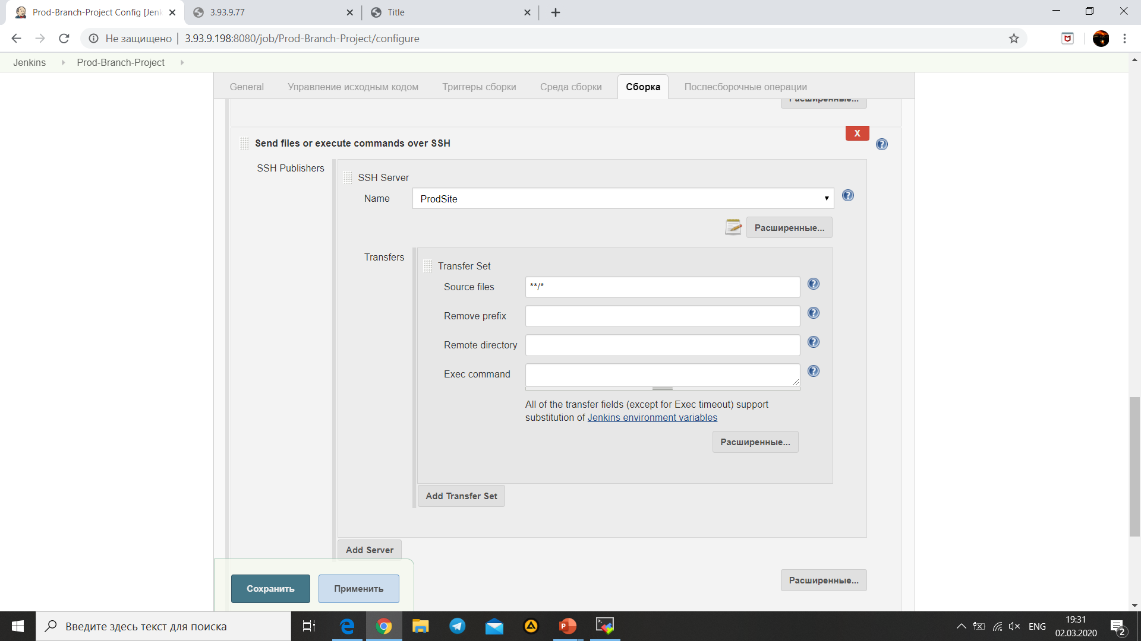
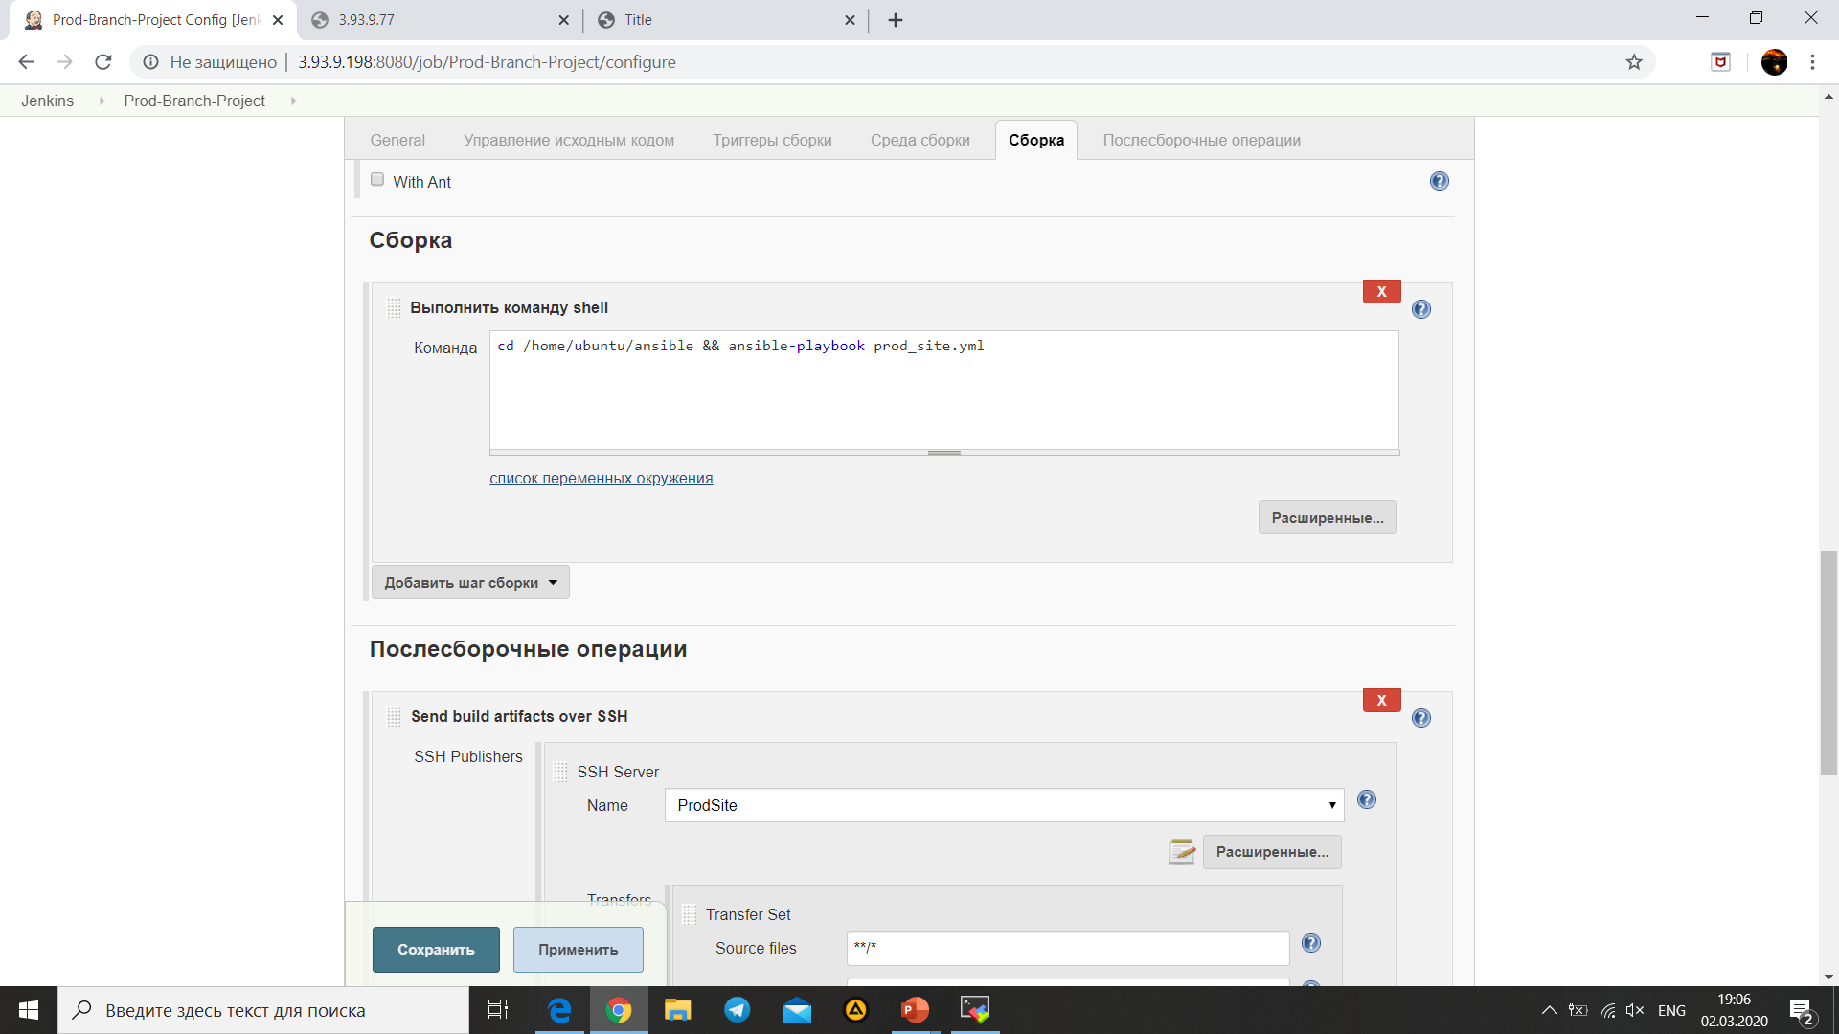
Configure Prod-branch project
Selection github repository
Ssh connect
Shell command

Slide 5

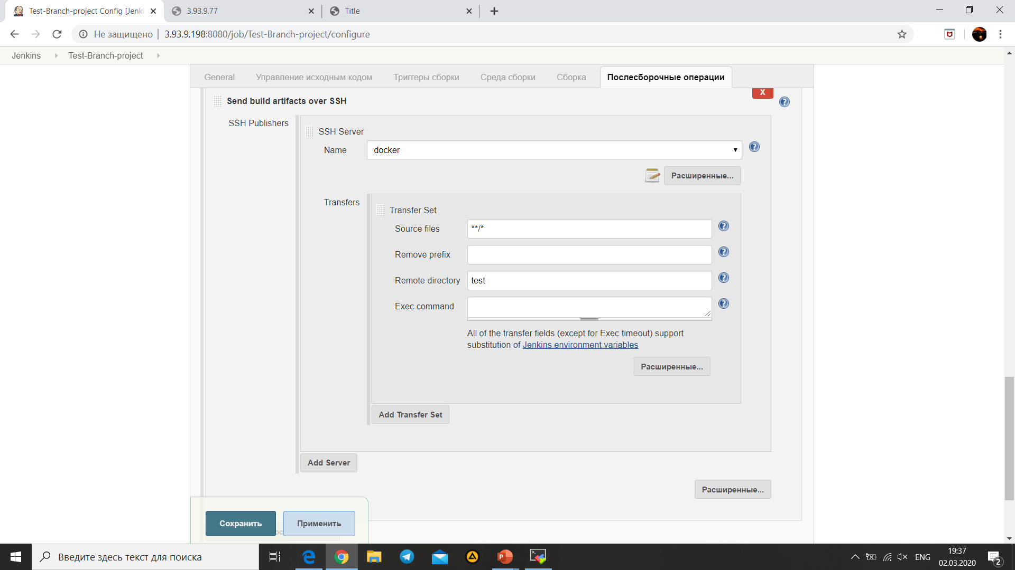
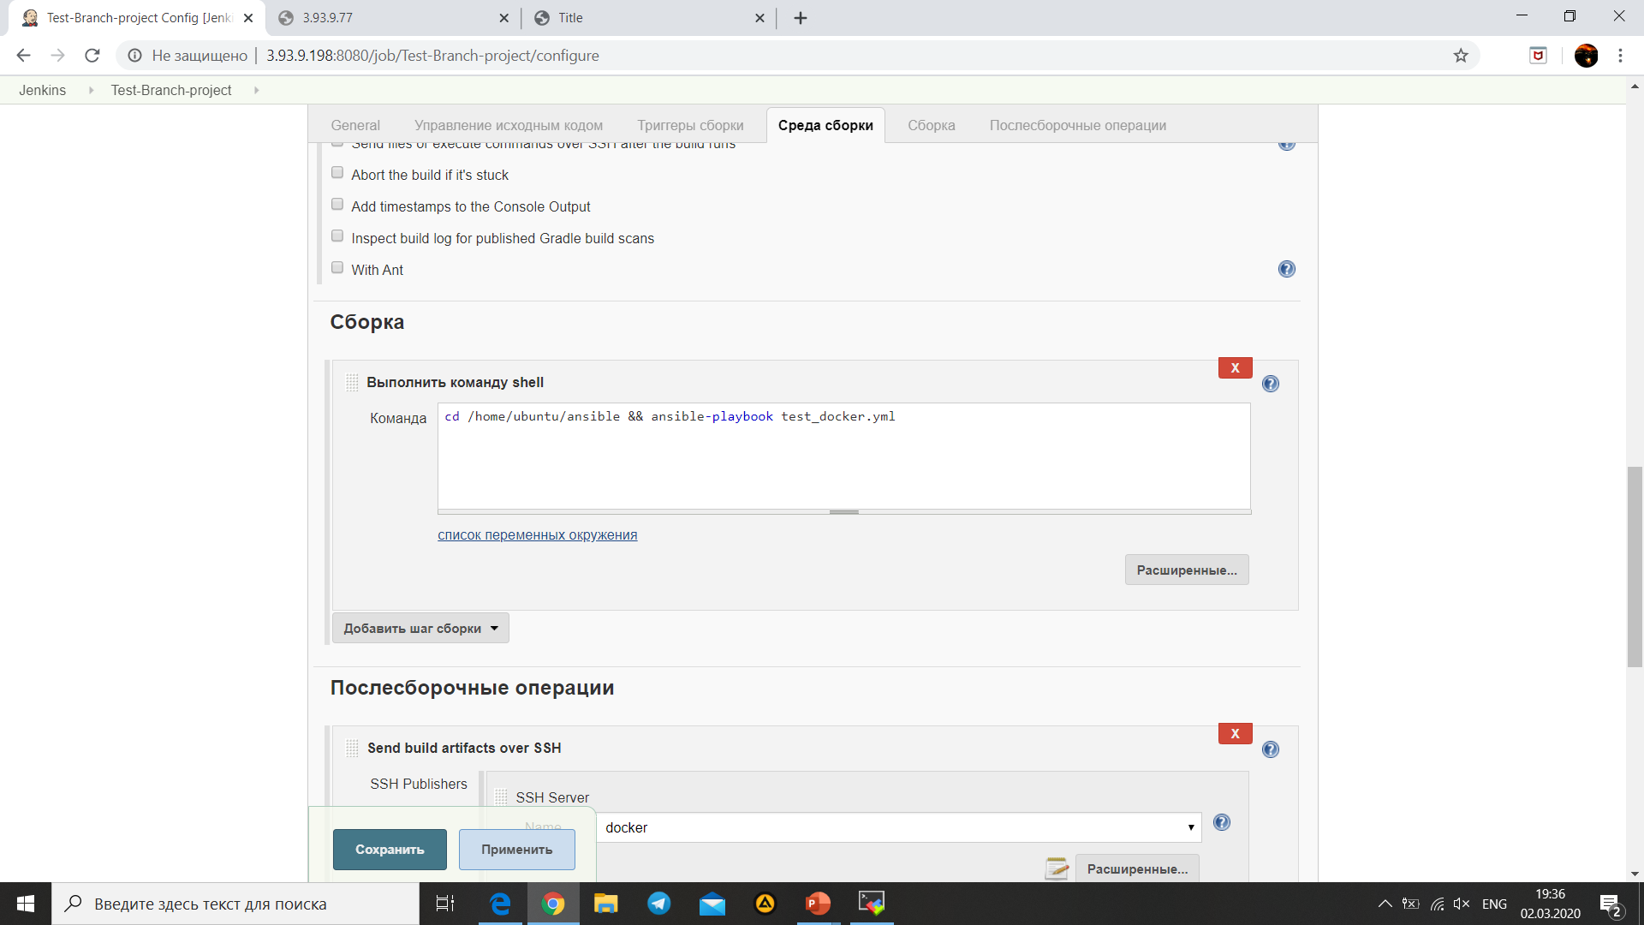
Configure Test-branch project
Selection github repository
Ssh connect
Shell command

Slide 6
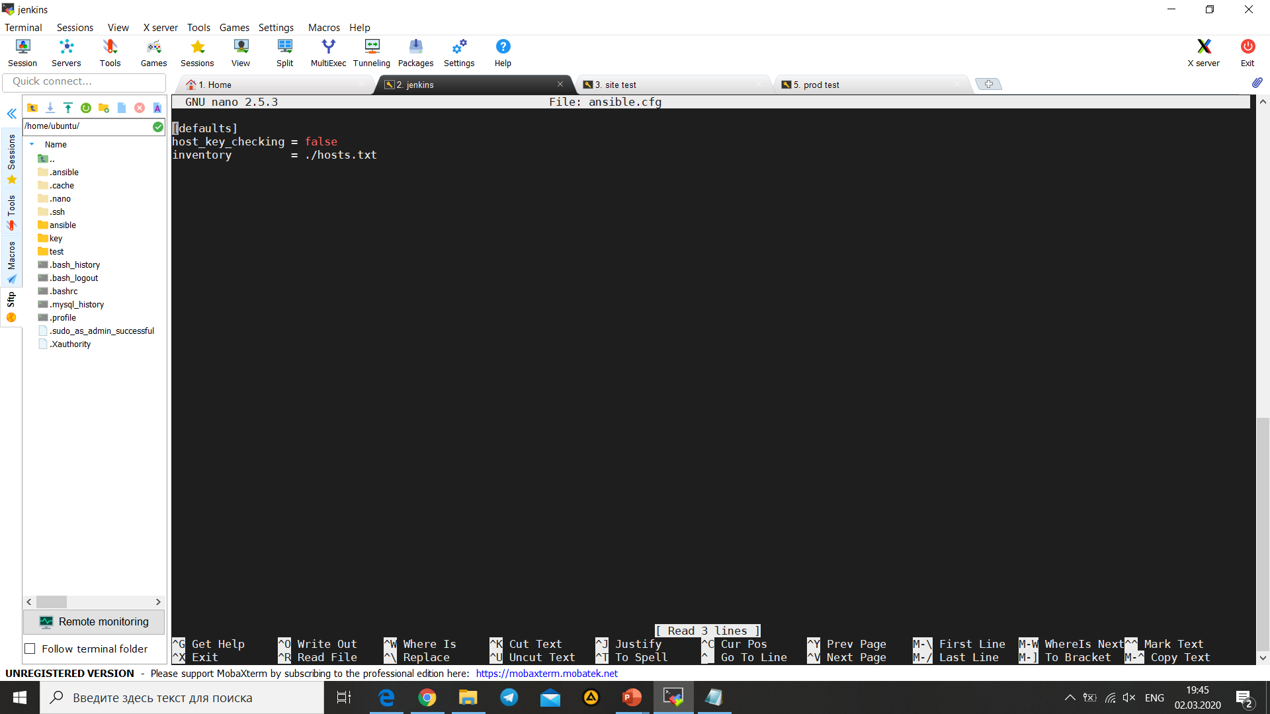
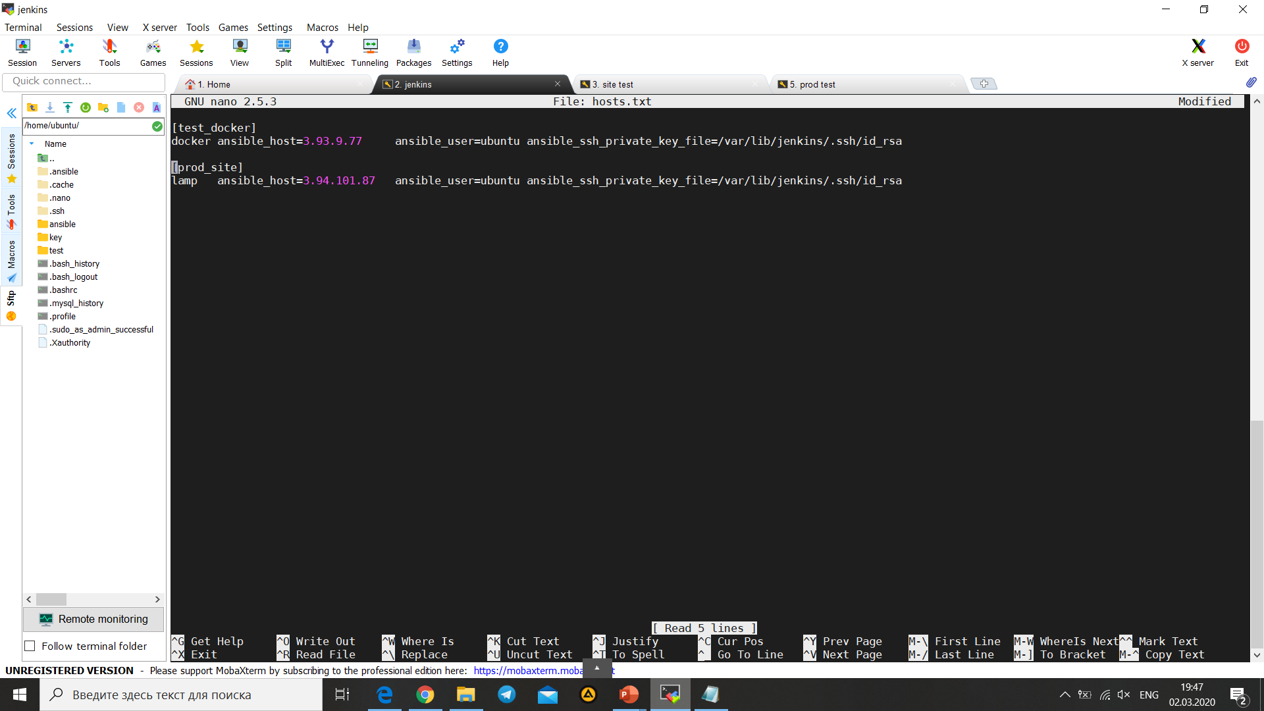
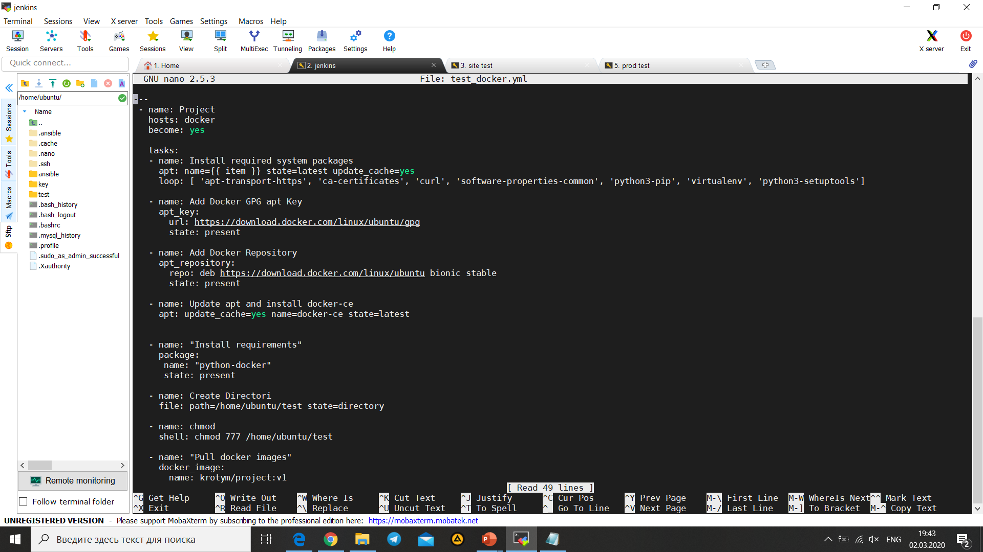
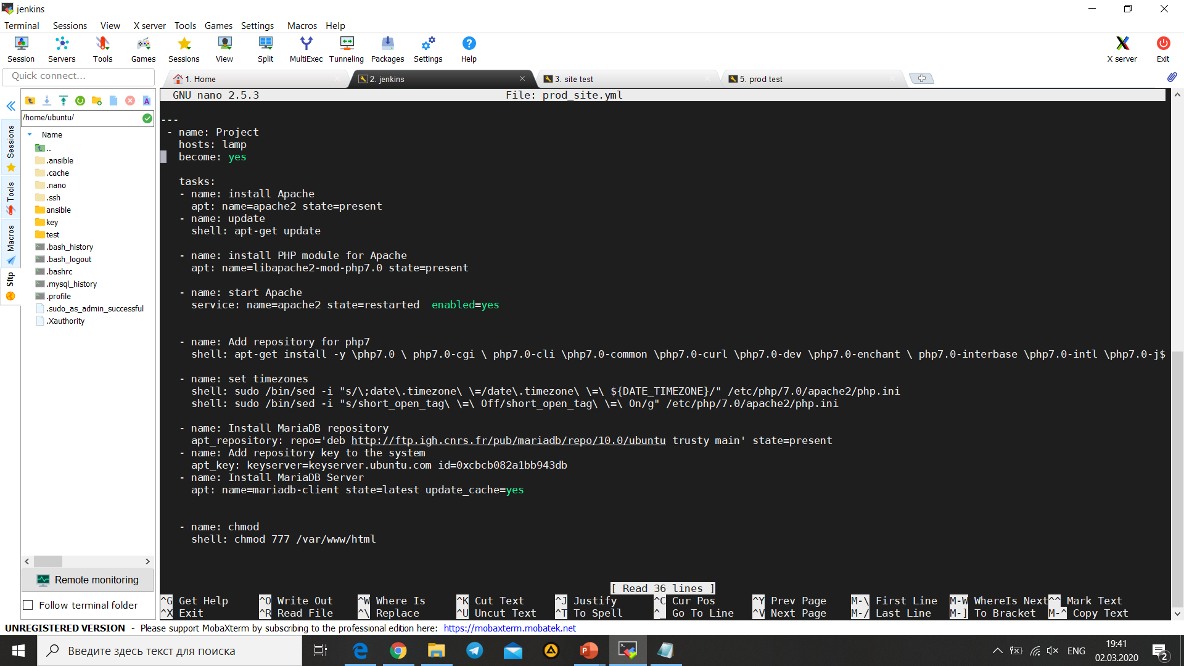
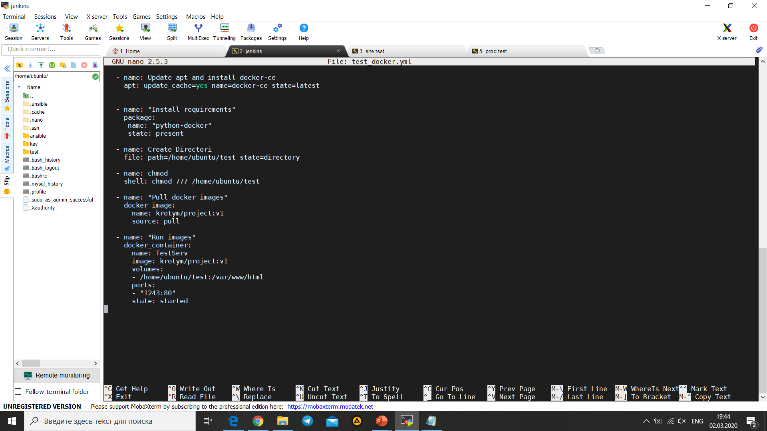
Asible-playbooks
ansible.cfg
hosts.txt
test_docker.yml
prod_site.yml

Slide 7
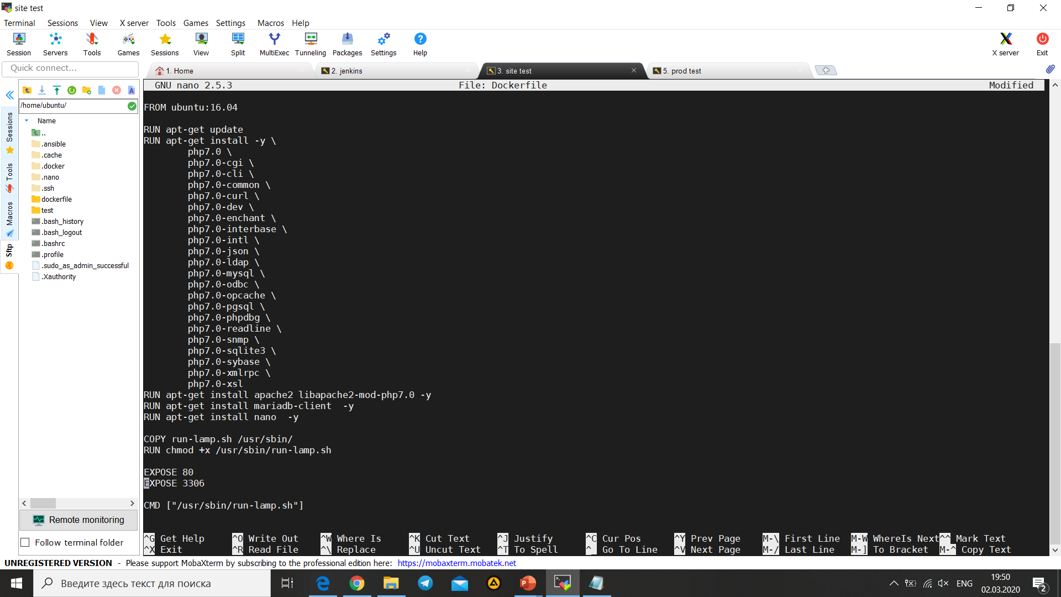
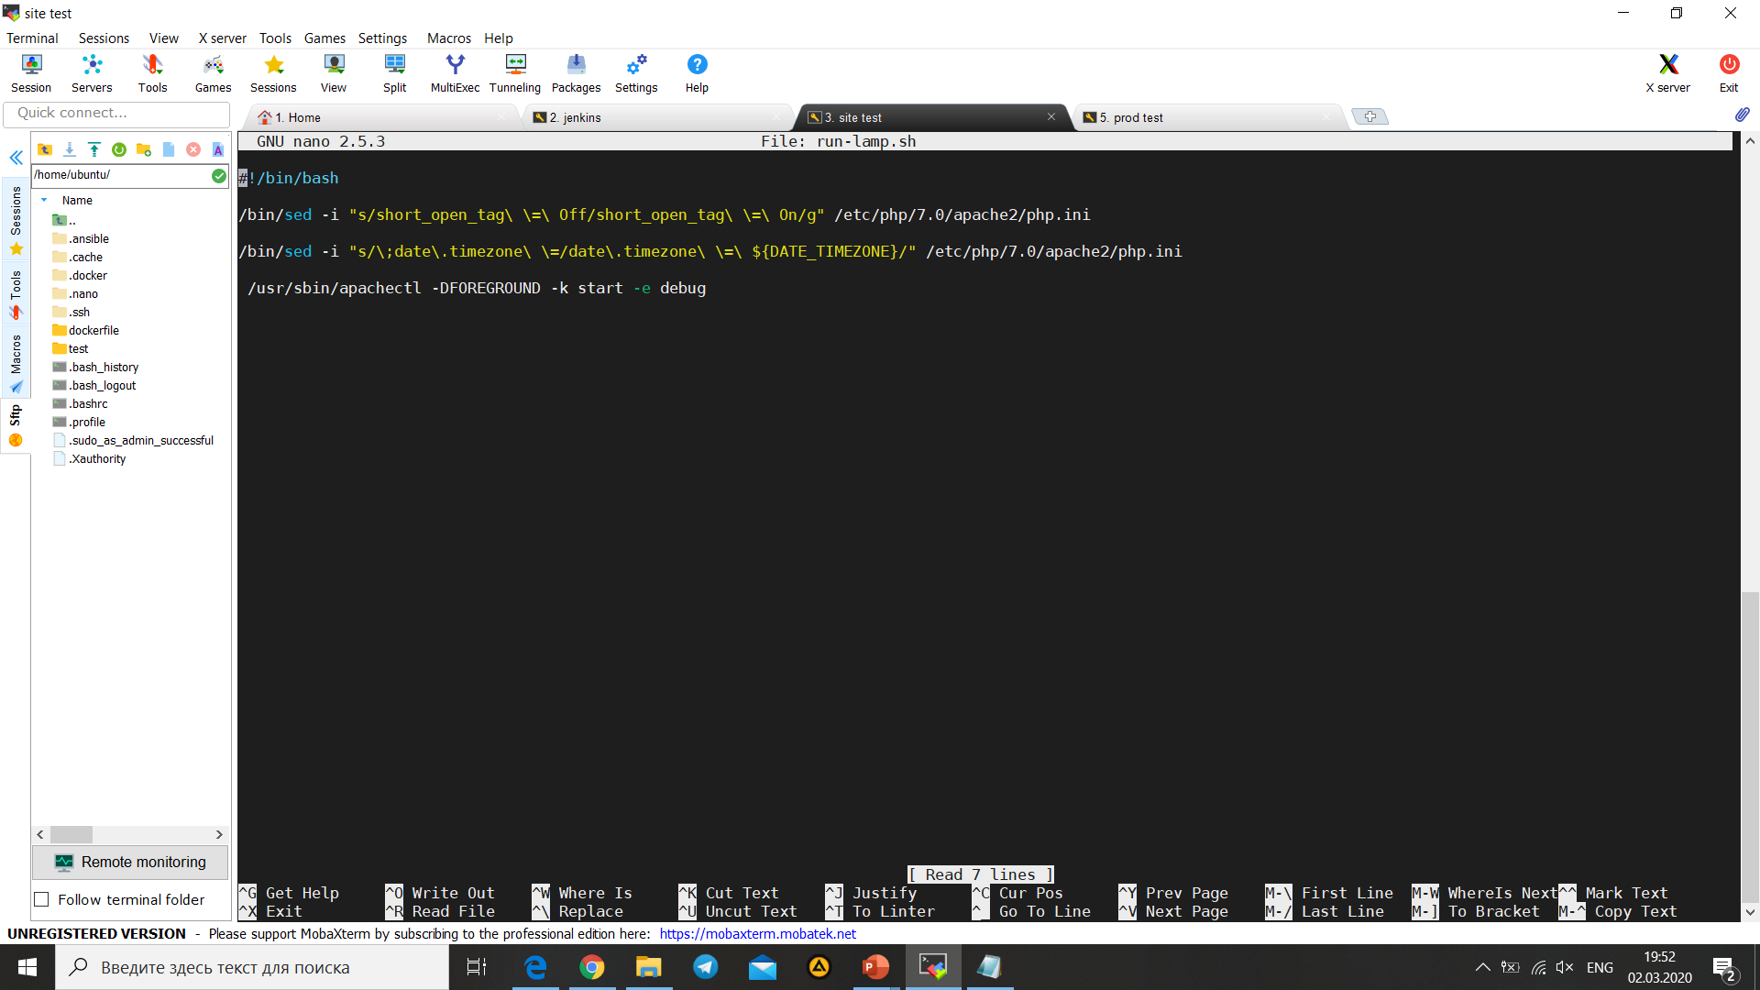
Docker config
run-lamp.sh
This is my dockerfile, I create it and push on DockerHub.
Dockerfile

Slide 8
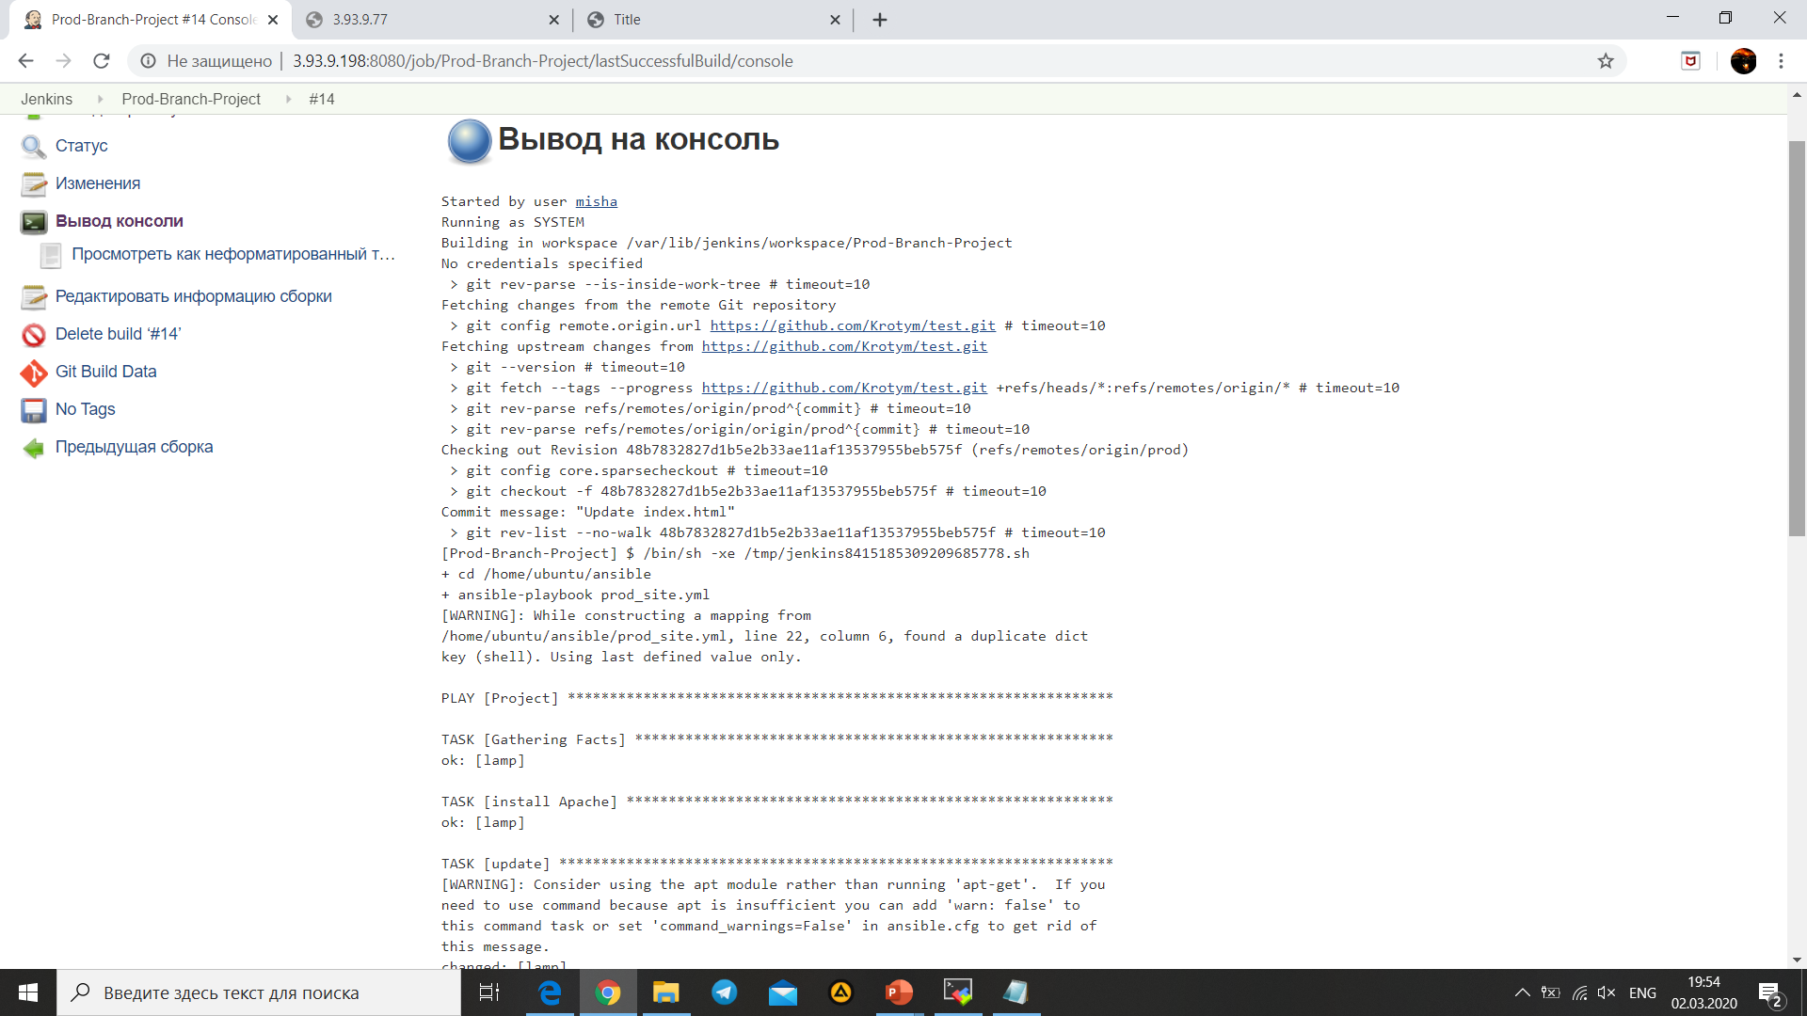
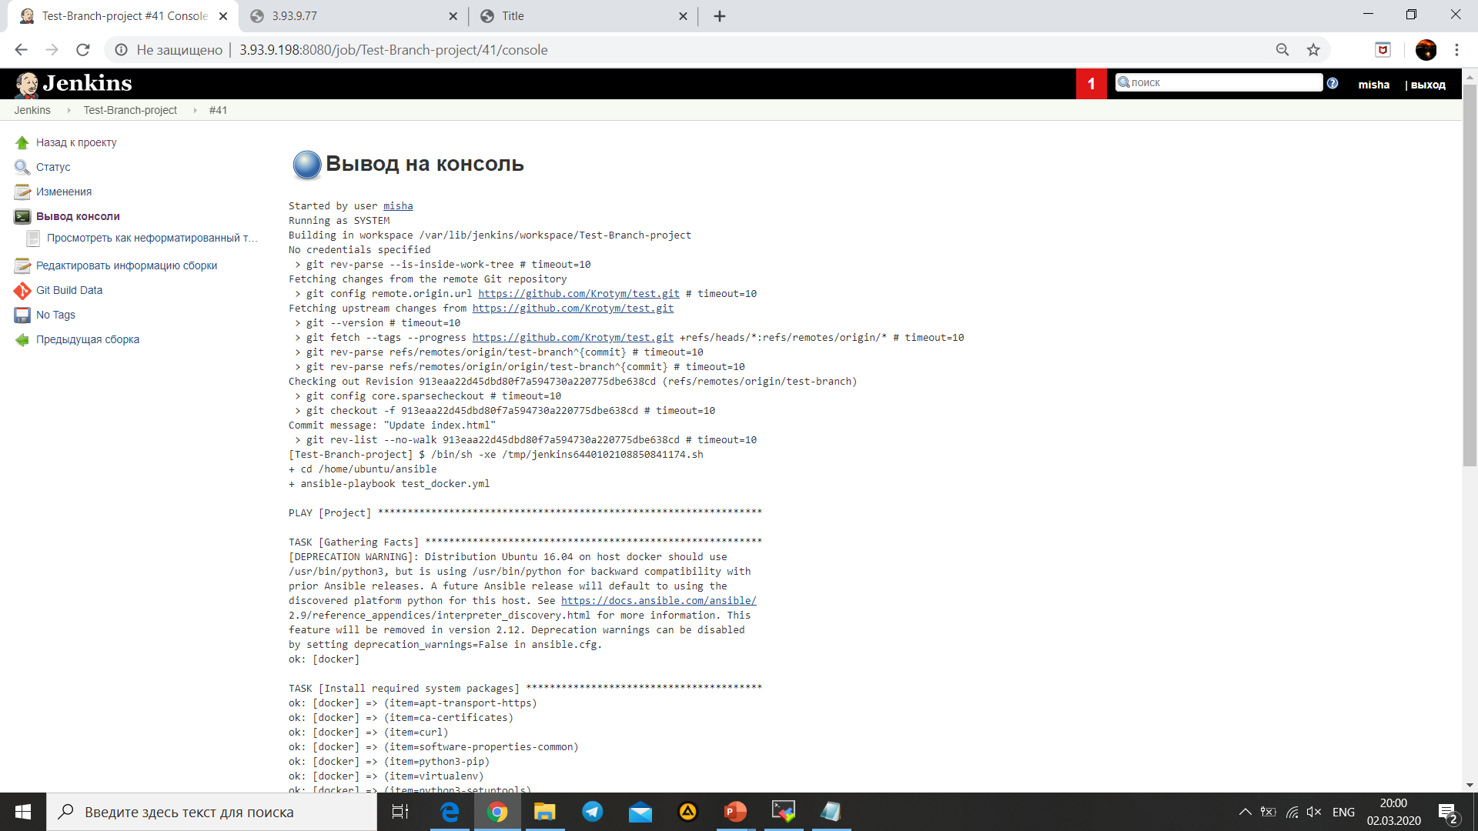
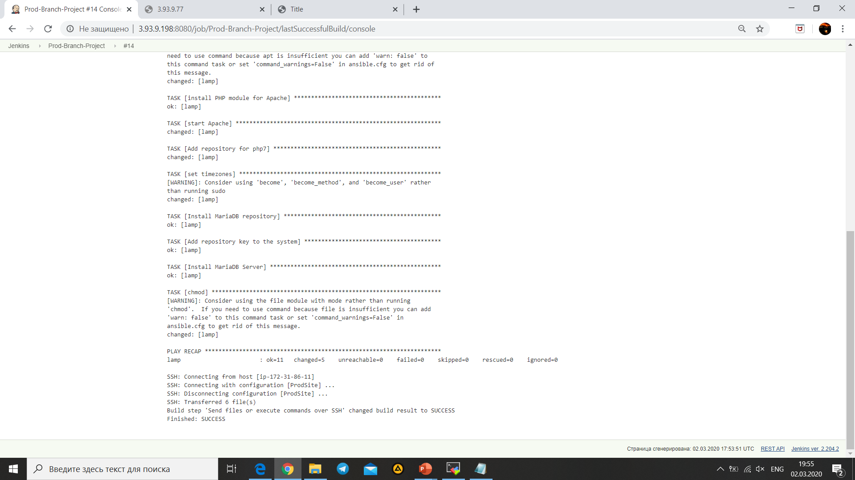
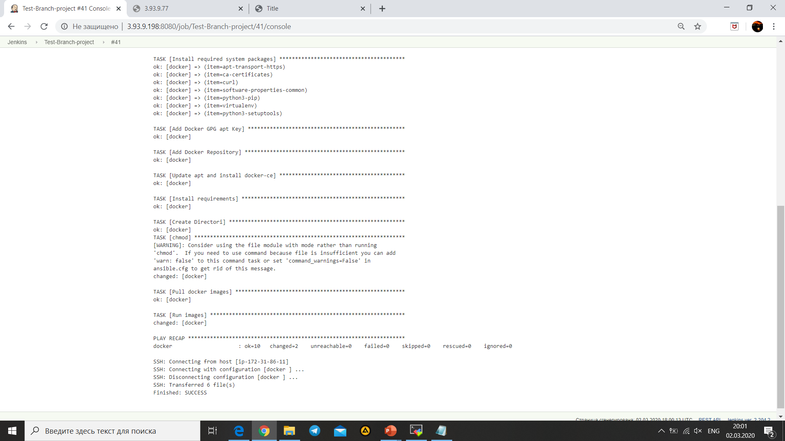
Output Prod-branch project
Output Test-branch project

Slide 9
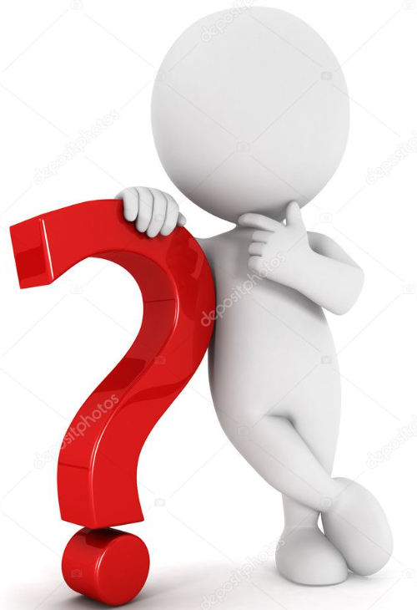
Questions?

